Slide 1



Event Tracker

Slide 2


About the project
What is this project about?
This project is inspired by an event manager application wherein users can efficiently organize, prioritize, and manage their events and schedules. This project allows individuals to set and schedule events, assign priority levels, and filter events based on their importance within a date range. The application combines logical sorting, filtering, and input validation to provide a seamless and user-friendly tracking. Users can keep their plans organized whether it’s an all day event of a specific time booked schedule

Slide 3
project Features
Event Creation and Management
Sorting and Prioritizing Events
Event Filtering by Date Range
Users can easily book an event by the time and date availability. This project is flexible to adjust schedule for certain events of all forms.
This application offers sorting features that allows users to organize events base on its date or priority. This allows users to have an organized schedule and prioritize their most to least important event.
Users can easily filter events they booked at a specific date range. This enables users to view and manage events within a particular timeframe, making it easier to track upcoming events.

Slide 4

Challenges
Faced
Coding Platform and Runtime
One of the challenges we faced was using different coding platforms. We tried using three different platforms: Google Colab, Jupyter Notebook, and Visual Studio Code. However, the Tkinter GUI did not work with the first two platforms, which required us to use the Visual Studio Code for the project execution. The runtime can also have an impact, as it varies from user to user. If more events are placed, the runtime can take a little while to respond.

Slide 5

The next slide is about the step by step execution of the project and its documentation.

Slide 6
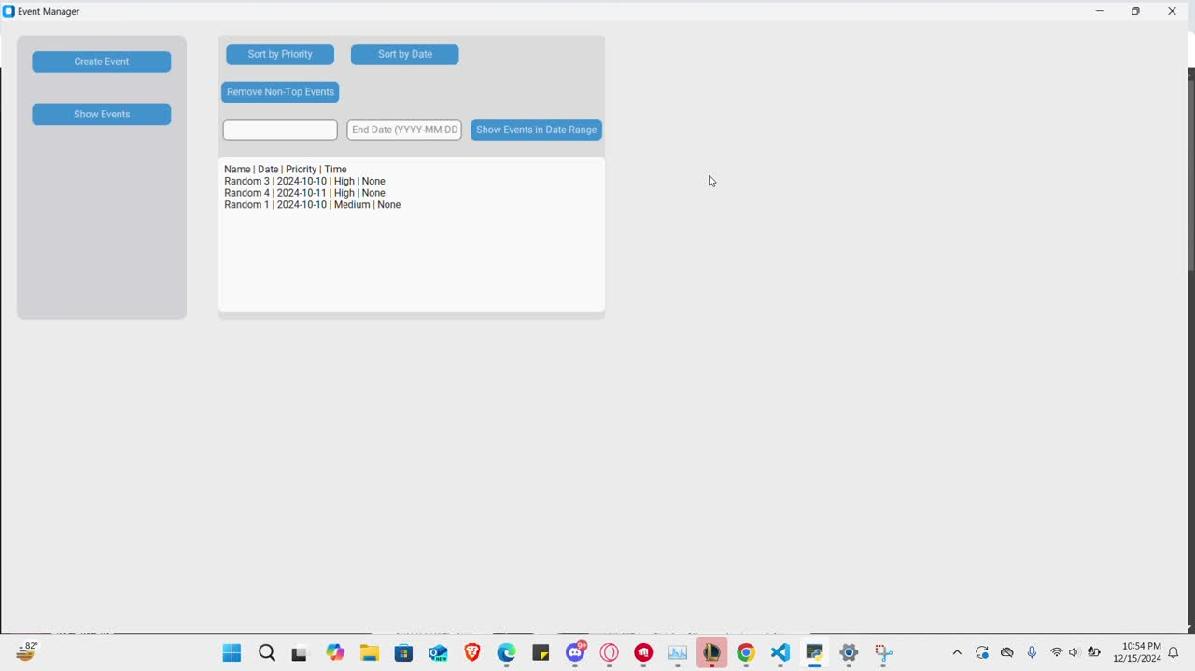
Click to play the video

Slide 7

Learnings and Conclusions
Managing Your Time for Optimal Productivity
This project enhanced and gained our knowledge about the problem that we encountered by exploring and using different coding platforms like Visual Studio Code. Due to the Tkinter GUI not working on Google Colab, which is the usual coding platform we used on the past assessments. We came up with using the VSCode as a better supporting tool for Tkinter. Also, the understanding of the value of good sorting platforms such as event manager or tracker, which really helps to easily plan and schedule important events to avoid forgetting the actual day or dates on a daily basis.

Slide 8
Thank you

